Slide 1

Secret Shop
Luxury watch collection

Slide 2

New Logo
Ryan Pidor
Rj Lucela

Slide 3
HOME
SHOP
ABOUT
CONTACT
CART
ALL BRANDS
SHOP INFO
CONTACT FORM
CHECK OUT
CHECK OUT
ITEM
ITEM DESC

Slide 4
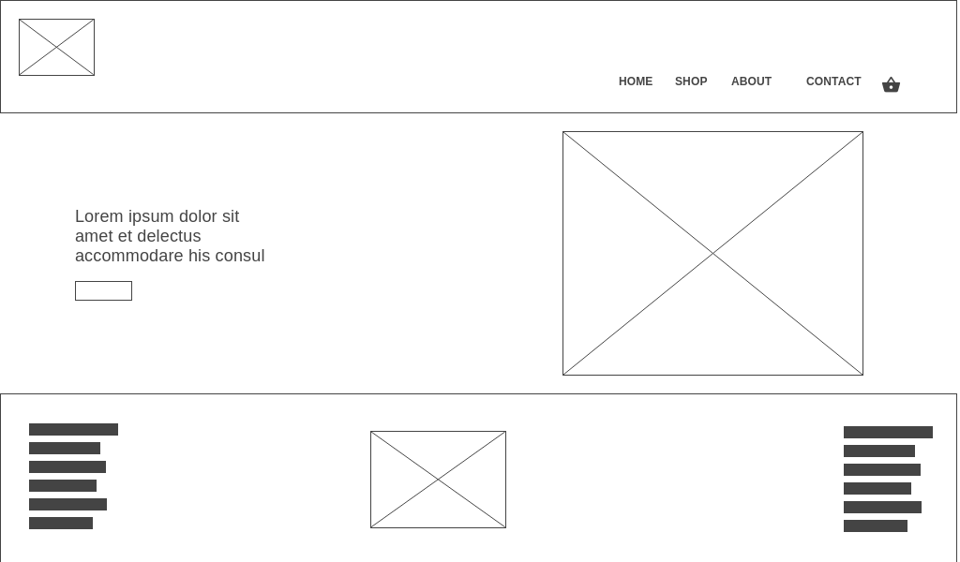

Slide 5
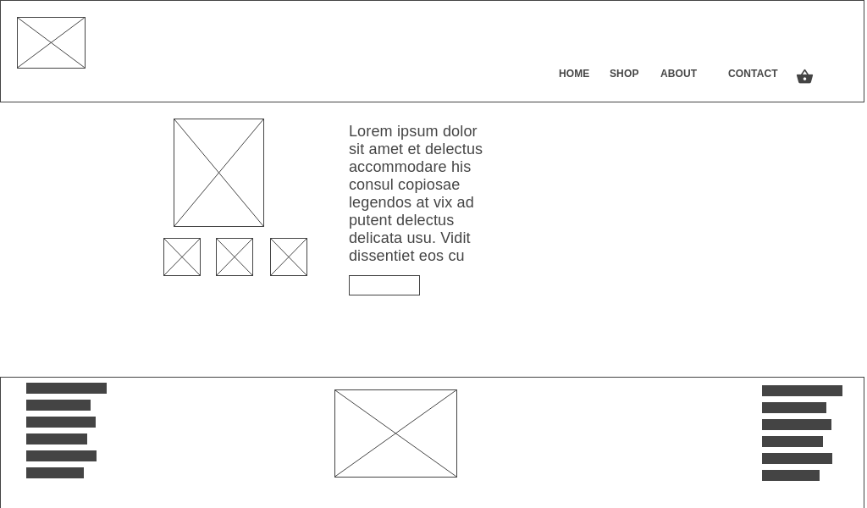

Slide 6
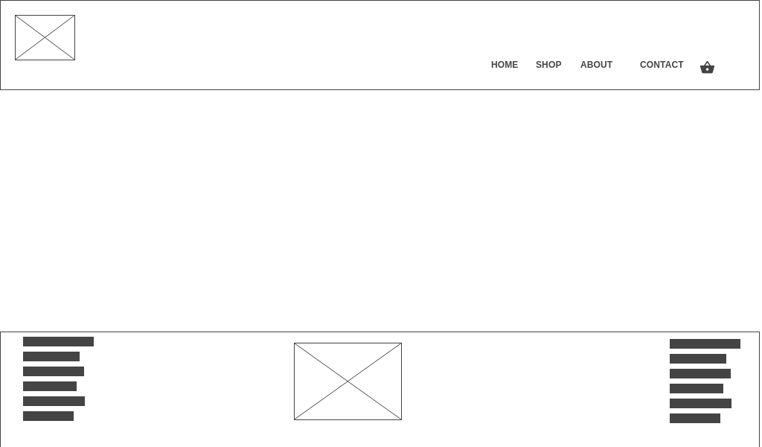

Slide 8
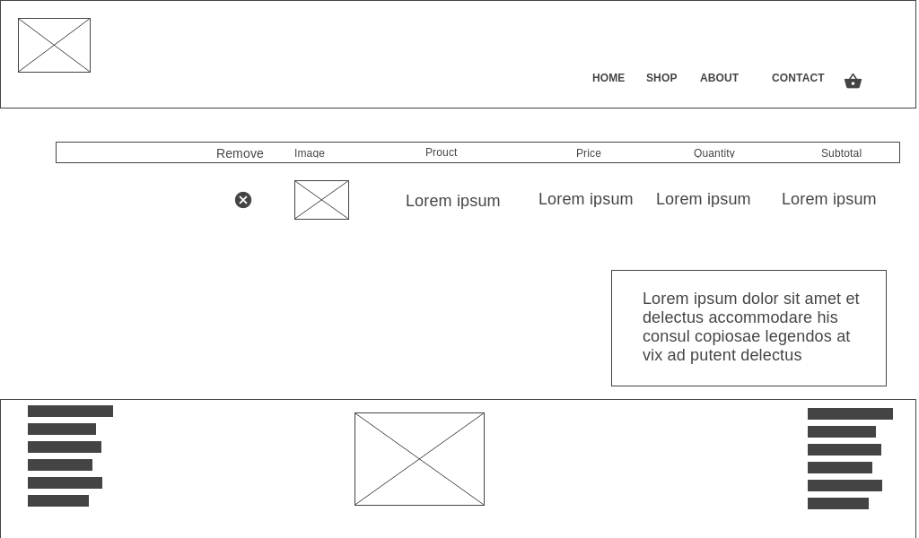

Slide 9
Providing Authentic watch
Luxury watches
Cheaper than Mall price
Collectors
Gift
Souvenir

Slide 10
HTML
CSS
Javascript
Bootstrap
Google font
Visual Studio

Slide 11
END

